Slide 1





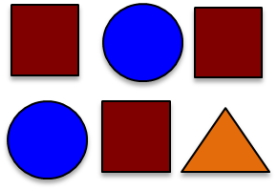











STEP 0 – STORE TO HDFS
3 - REDUCE
1 - MAP
2 – SHUFFLE
and SORT
Assume 4 data partitions.
1
1
1
1
1
1
( , _8_ )
1
1
1
1
( , _4_ )
1
1
( , _5_ )
1
( , _4_ )
1
1
1
( , _3_ )
1
1
1
1
1
1
1
1
1
1
1
1
1
1
1
1
1
1
1
1
1
1
1

